Slide 1
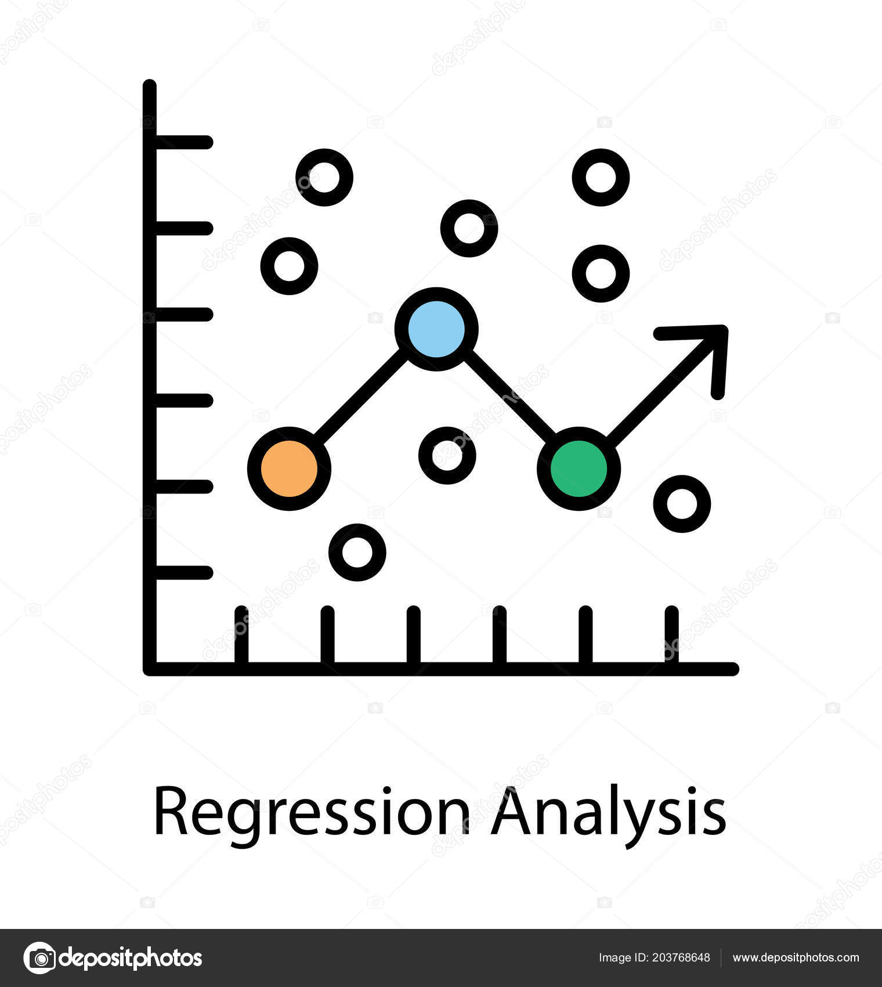
Engineering Statistics
Regression
Analysis
Dr. vvn Weian Chao (趙韋安)
https://ce.nctu.edu.tw/member/teachers/23
Department of Civil Engineering, National Yang Ming Chiao Tung University, Taiwan

Slide 2

Purpose
單變數
進入
多變數

Slide 3
多變數關係
關係強度

Slide 4
R: Useful function
cor().-相關係數
lm().-迴歸分析
anova().-變異數分析
lowess().-平滑曲線

Slide 5
Outline
-Scatter plots
-Correlation
-Fitting a Line to Bivariate Data
-Nonlinear Relationships
-Using More than One Predictor

Slide 6
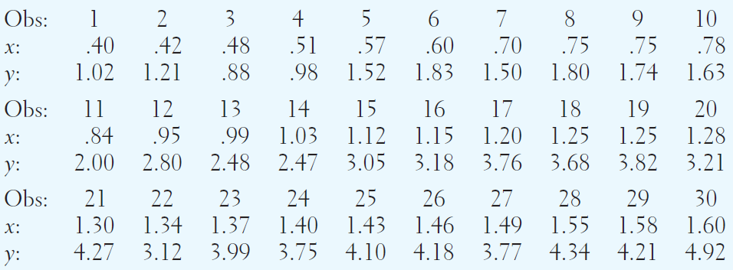
Scatter plots
應變數(Y): Ocular Surface Area, 視覺表面積[cm²]
自變數(X): 眼睛之間的寬度 [cm]
資料個數: 30筆, data.xlsx

Slide 7
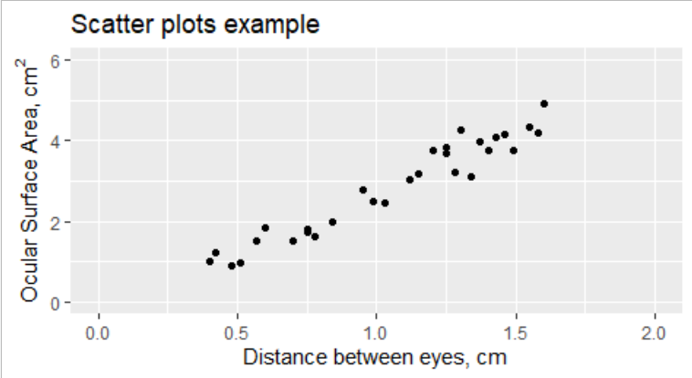
Scatter plots
X增加, Y亦增加
線性關係?
是否通過原點? (符合物理意義)

Slide 8
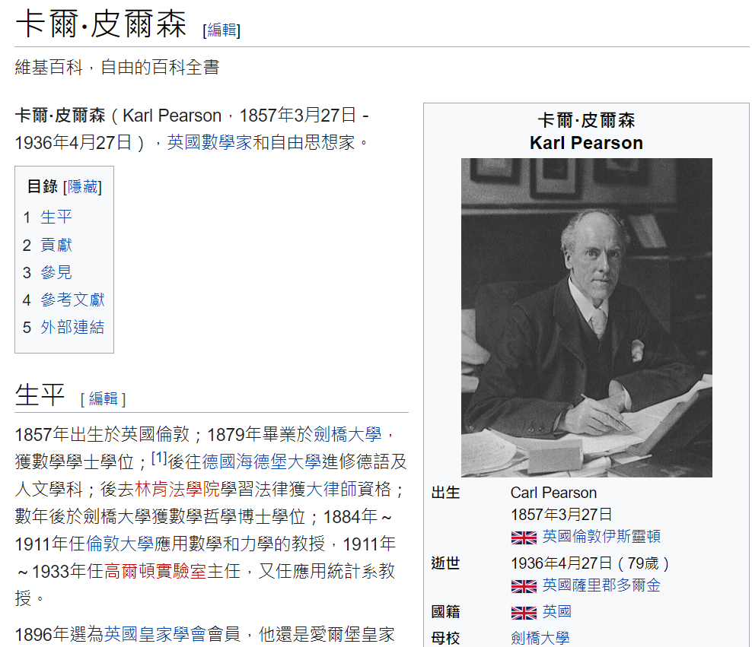
Correlation
Pearson’s Sample Correlation Coefficient
Properties & Interpretation of r
Correlation & Causation
https://zh.wikipedia.org/wiki/%E5%8D%A1%E5%B0%94%C2%B7%E7%9A%AE%E5%B0%94%E9%80%8A

Slide 9
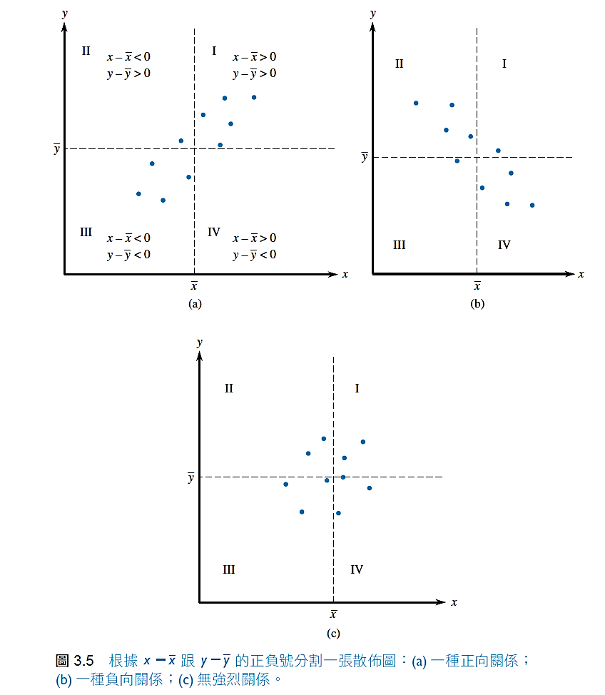
Pearson Correlation Coefficient (r)
Multiply each x deviation by the corresponding y deviation to obtain products of deviations of the form
(x-x_avg)(y-y_avg).
Fig.a, because almost all points lie in regions I and III, almost all products of deviations are positive. Thus the sum of products will be a large positive number.
Fig.b exhibits a strong negative relationship.
In Fig.c, positive and negative products of deviations tend to counteract on another, giving a value of the sum that is close to zero.

Slide 10
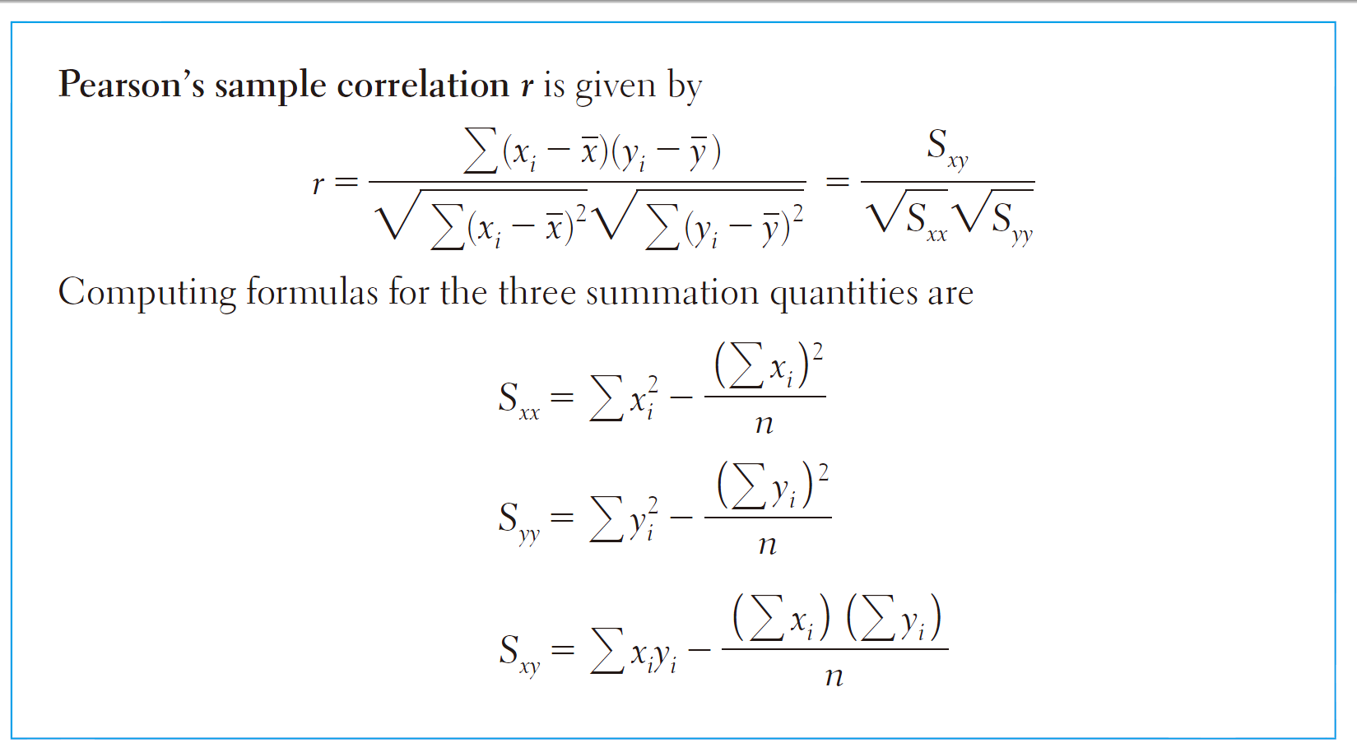
Pearson Correlation Coefficient (r)
平方和
和平方

Slide 11
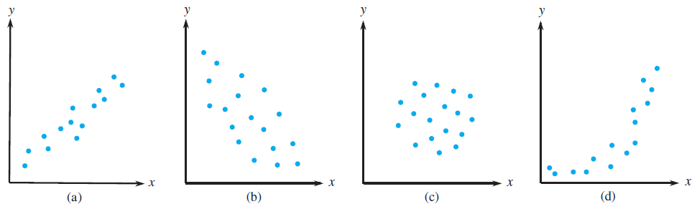
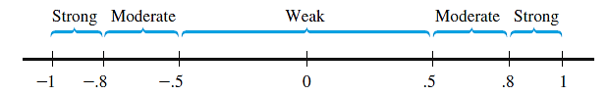
Properties & Interpretation of r

Slide 12
R: Correlation Coefficient
cor().

Slide 13


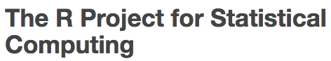
R語言使用希臘字母與上下標符號 expression
-Use the expression(): ^上標 [ ]下標 ~空格 *連接符號
expression(“cm”^"2"~)
-> cm²

Slide 14
TRY
it
in
R

Slide 15
R: Correlation Coefficient
R_regression_a.R

Slide 16
Correlation & Causation
實際上，雖觀察到兩變數具有極高相關係數，並非真正代表兩個變數之間確實存在因果關係
因為，有可能兩個變數同時與第三個變數存在強烈的關係
小孩牙齒數量與說話能力有正相關。但是，實際上牙齒數量與說話能力皆與年齡有明確關係，當分析時固定年齡，則兩者變數之間關係會變小

Slide 17
Fitting a Line to
Bivariate Data
Fitting a Straight Line
Assessing the Fit of the Least Squares Line
Standard Deviation about the LS Line
Plotting the Residuals
Resistant Lines
Y= SLOPE ✕ X+ INTERCEPT

Slide 18
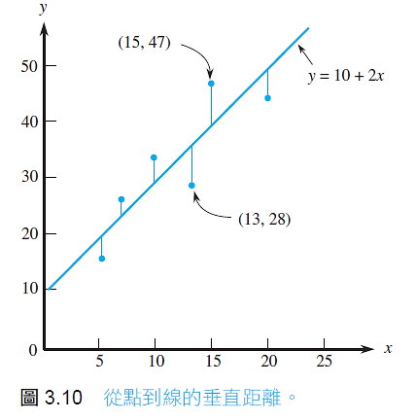
Fitting a Straight Line
The principle of least squares:
It is assumed that there are no errors in the x-value.
The line that gives the best fit to the data is the one that minimizes the sum.
It is called the least squares line or sample regression line.

Slide 19
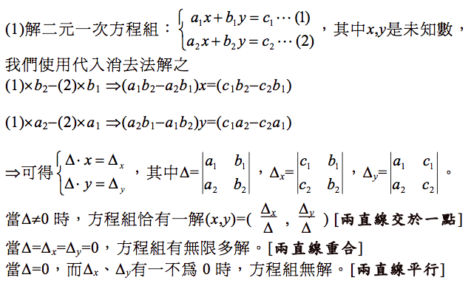
Fitting a Straight Line

Slide 20
Fitting a Straight Line
The slope b of the least squares line is:
The vertical intercept a of the least squares line is

Slide 21
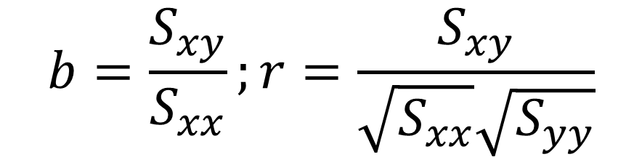
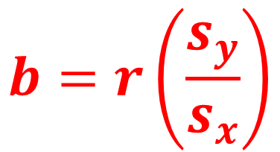
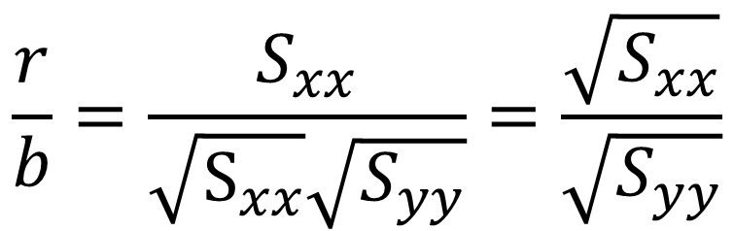
Fitting a Straight Line
$$b=\frac{S_{xy}}{S_{xx}};r=\frac{S_{xy}}{\sqrt{S_{xx}}\sqrt{S_{yy}}}$$
If r/b, then
$$\frac{r}{b}=\frac{S_{xx}}{\sqrt{S_{xx}}\sqrt{S_{yy}}}=\frac{\sqrt{S_{xx}}}{\sqrt{S_{yy}}}$$
$$b=r\left(\frac{s_{y}}{s_{x}}\right)$$
相關係數r控制斜率正負
x,y變數的標準差及r控制斜率大小

Slide 22
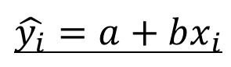
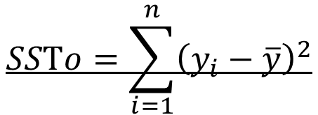
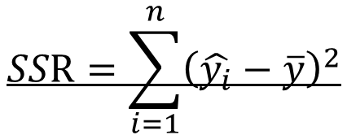
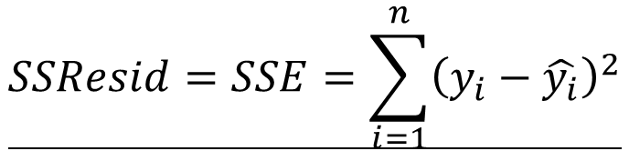
Assessing the Fit of
LS Line
Predicting the y values:
$$\hat{y_{i}}=a+bx_{i}$$
Residual sum of squares (殘差平方和), SSResid, Error sum of squares SSE :
$$SSResid=SSE=\sum_{i=1}^{n}{{\left(y_{i}−\hat{y_{i}}\right)}^{2}}$$
Regression of sum of squares (迴歸平方和), SSR:
$$SSR=\sum_{i=1}^{n}{{\left(\hat{y_{i}}−\overline{y}\right)}^{2}}$$
Total sum of squares (總平方和), SSTo:
$$SSTo=\sum_{i=1}^{n}{{\left(y_{i}−\overline{y}\right)}^{2}}$$

Slide 23

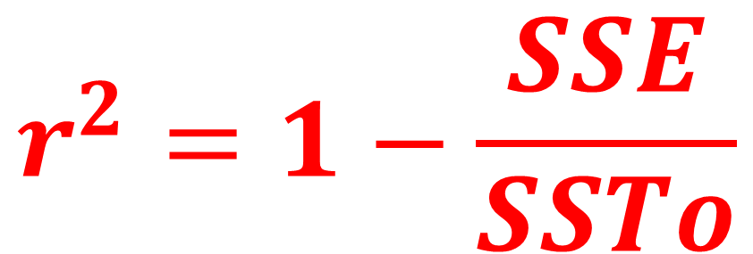
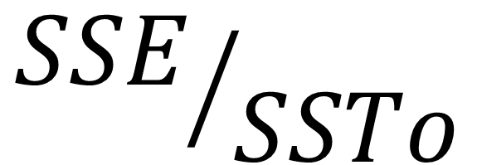
Assessing the Fit of
LS Line
$$SSTo=SSE+SSR$$
迴歸關係式無法解釋的資料比例:
$${SSE}/{SSTo}$$
Coefficient of Determination (決定係數): 可度量迴歸線對於資料的擬合程度
$$r^{2}=1−\frac{SSE}{SSTo}$$

Slide 24
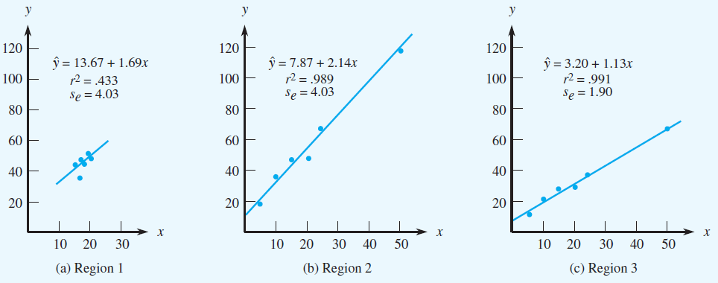
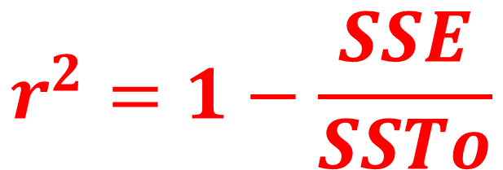
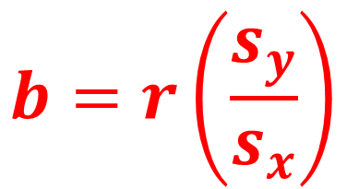
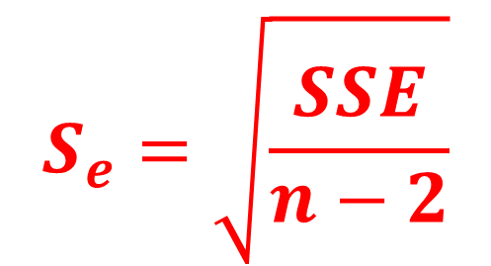
Standard Deviation about
the LS Line
We have n degrees of freedom. We use two degrees of freedom in calculating the slope and intercept, leaving n-2 degrees of freedom in subsequent calculations.
$$S_{e}=\sqrt{\frac{SSE}{n−2}}$$
$$b=r\left(\frac{s_{y}}{s_{x}}\right)$$
$$r^{2}=1−\frac{SSE}{SSTo}$$
度量觀測值在迴歸線的分散程度

Slide 25
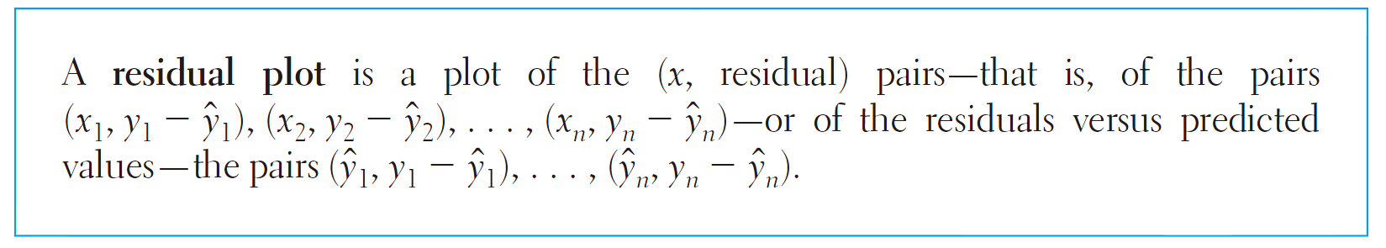
Plotting the Residuals
理想的迴歸關係式之Residual plot
並無明顯的殘差值之
分布趨勢

Slide 26
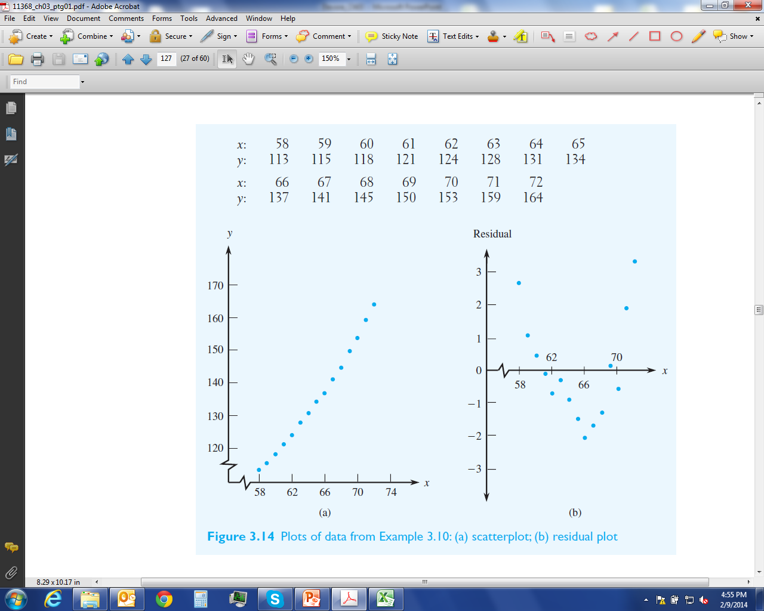
Plotting the Residuals
應變數(Y): 美國女性體重[lb]
自變數(X): 身高 [inch]
資料個數: 15筆

Slide 27
Resistant Lines
迴歸線容易受到單一不好的觀測值影響迴歸結果。此類情況，可以使用權重法線性迴歸

Slide 28
補充: 檢查偏離值與權重式迴歸分析
透過殘差值定義各別資料點(x,y)的權重，並將所有資料點乘上對應的權重值

Slide 29
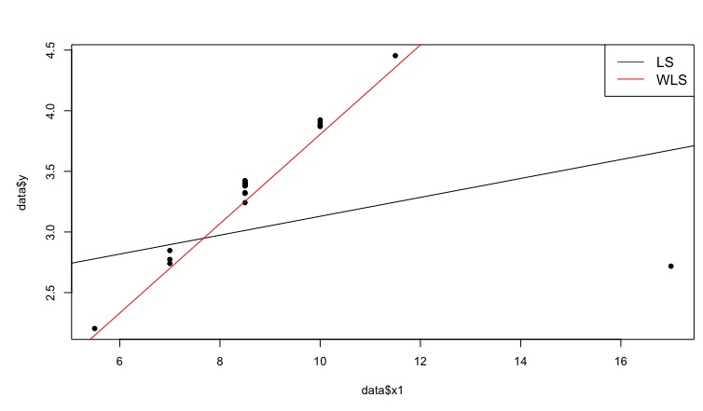
補充: 檢查偏離值與權重式迴歸分析
透過乘上權重值的資料點再進行回歸分析

Slide 30
R: Fitting a Straight Line
lm(y~x).
anova().

Slide 31
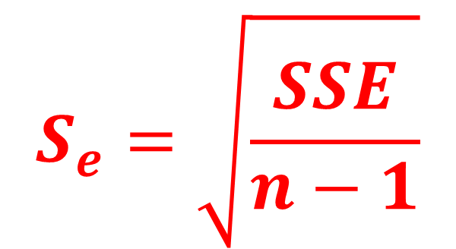
R: Fitting a Straight Line without intercept
lm(y~x+0).
We have n degrees of freedom. We use two degrees of freedom in calculating the slope only, leaving n-1 degrees of freedom in subsequent calculations.
$$S_{e}=\sqrt{\frac{SSE}{n−1}}$$

Slide 32
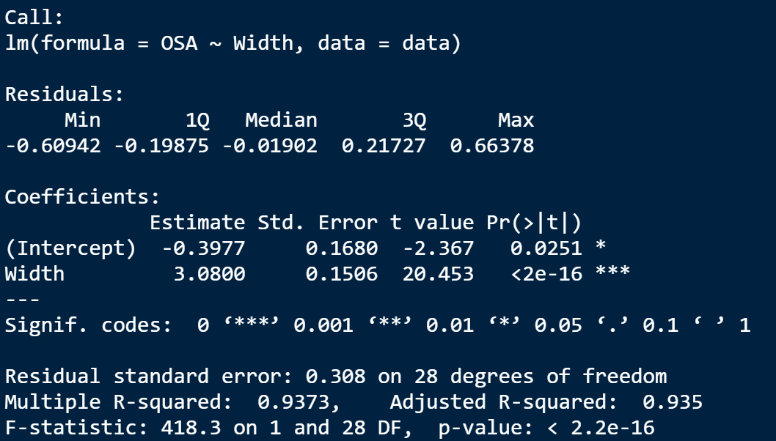
R: Fitting a Straight Line
summary(model)
Intercept: -0.3977
Slope: 3.0800
se: 0.308
r²: 0.9373

Slide 33
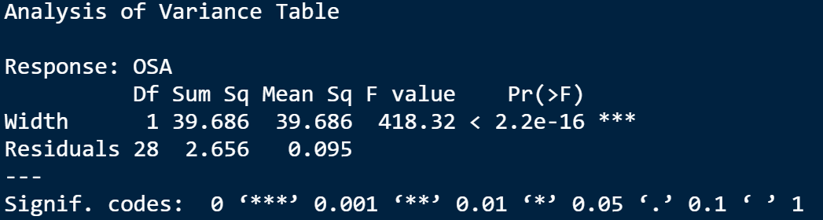

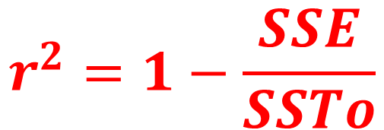

R: Fitting a Straight Line
anova(model): Analysis of Variance Table
SSE=2.656
SSR=39.686
$$SSTo=SSE+SSR$$
$$S_{e}=\sqrt{\frac{SSE}{n−2}}$$
$$r^{2}=1−\frac{SSE}{SSTo}$$

Slide 34
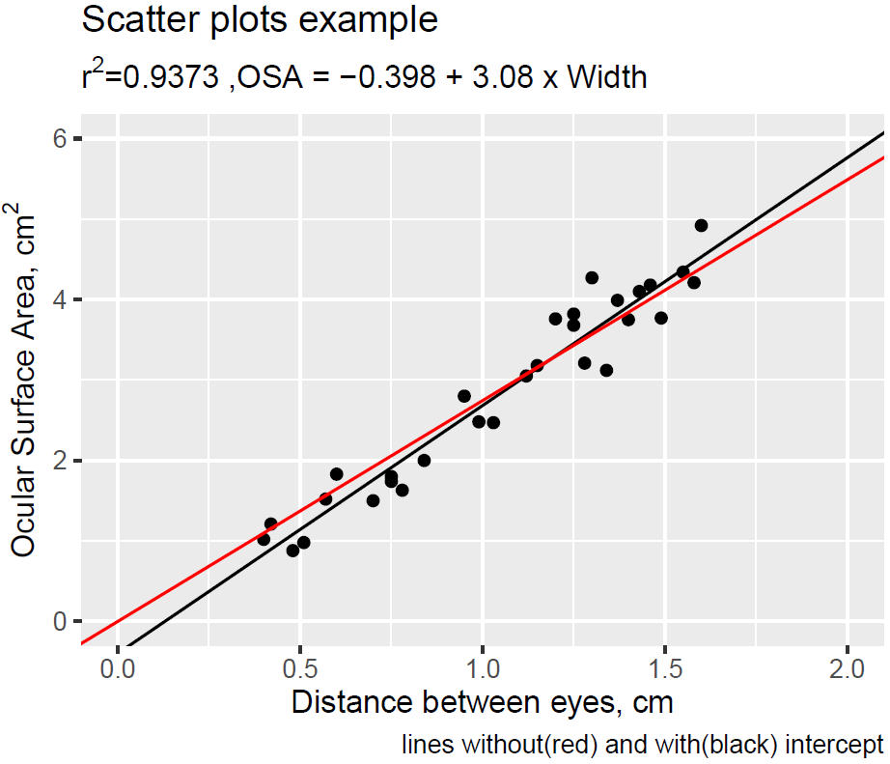
R: Fitting a Straight Line
主標題
次要標題
圖說

Slide 35
R: subtitle and caption
labs(
title =
,subtitle =
,caption =
,x =
,y = )

Slide 36
TRY
it
in
R

Slide 37
R: Fitting a Straight Line
R_regression_a.R

Slide 38
Nonlinear Relationships
Power Transformations
非線性 -> 線性化…
Fitting a Polynomial Function
多項式曲線(非線性)
Smoothing a Scatterplot
平化化數據 -> 突顯資料趨勢關係

Slide 39
Power Transformations
Suppose the general pattern in a scatterplot is curved and monotonic (i.e., strictly increasing/decreasing); it is often possible to find a power transformation for x or y.
By a power transformation, we mean the use of exponents p and q such that the transformed values are x′= x^{p} and/or y′= y^{q}
The relevant scatterplot is of the (x′, y′) pairs.

Slide 40
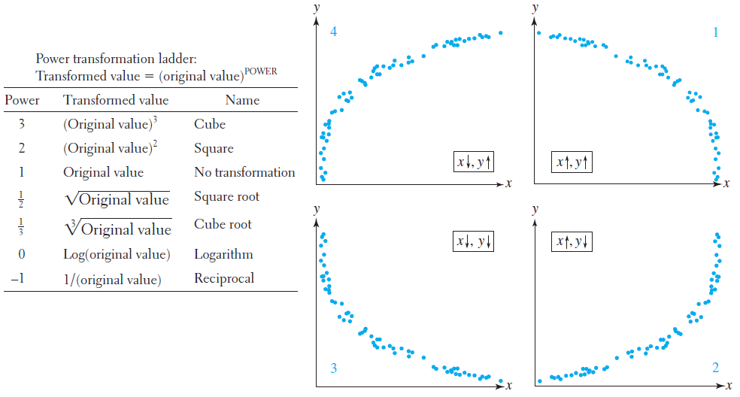
Power Transformations
y−
x+

Slide 41
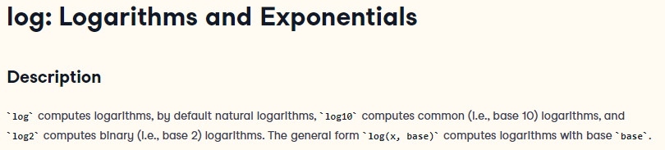

Slide 42
Power Transformations
應變數(Y): 玉米脆片的溼度[%]
自變數(X): 油炸時間 [sec]
資料個數: 8筆, data_power.xlsx
Moisture = a x time ^{b}
ln(Moi) = ln(a)+b x ln(time)

Slide 43
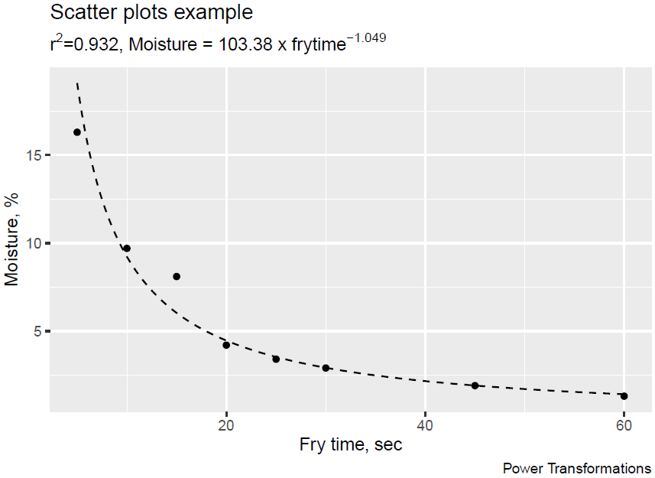
R: Power Transformation

Slide 44
TRY
it
in
R

Slide 45
R: Power Transformation
R_regression_b.R

Slide 46
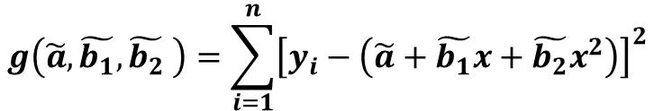
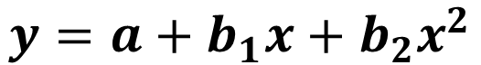
Fitting a Polynomial Function
應變數(Y): 葡萄糖濃度[%]
自變數(X): 發酵時間[day]
資料個數: 8筆, data_conc.xlsx
$$y=a+b_{1}x+b_{2}x^{2}$$
$$g\left(\tilde{a},\tilde{b_{1}},\tilde{b_{2}} \right)=\sum_{i=1}^{n}{{\left[y_{i}−\left(\tilde{a}+\tilde{b_{1}}x+\tilde{b_{2}}x^{2}\right)\right]}^{2}}$$

Slide 47
R: Fitting a Polynomial Function
lm(y~x+I(x^2)).

Slide 48
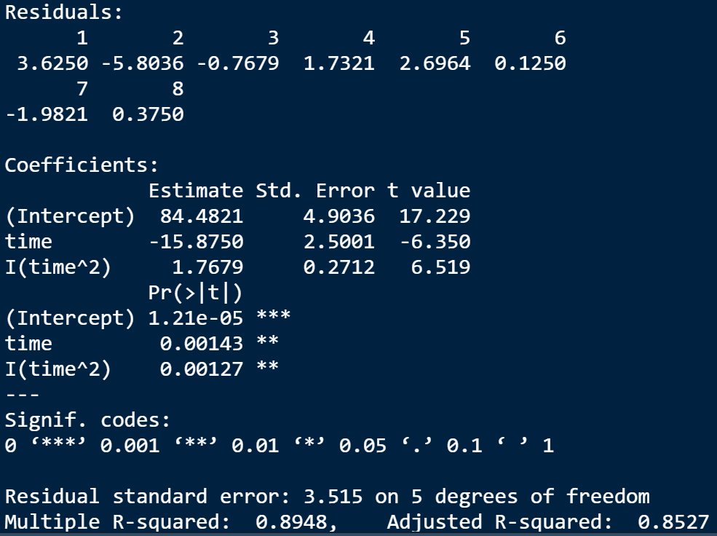
R: Fitting a Polynomial Function

Slide 49
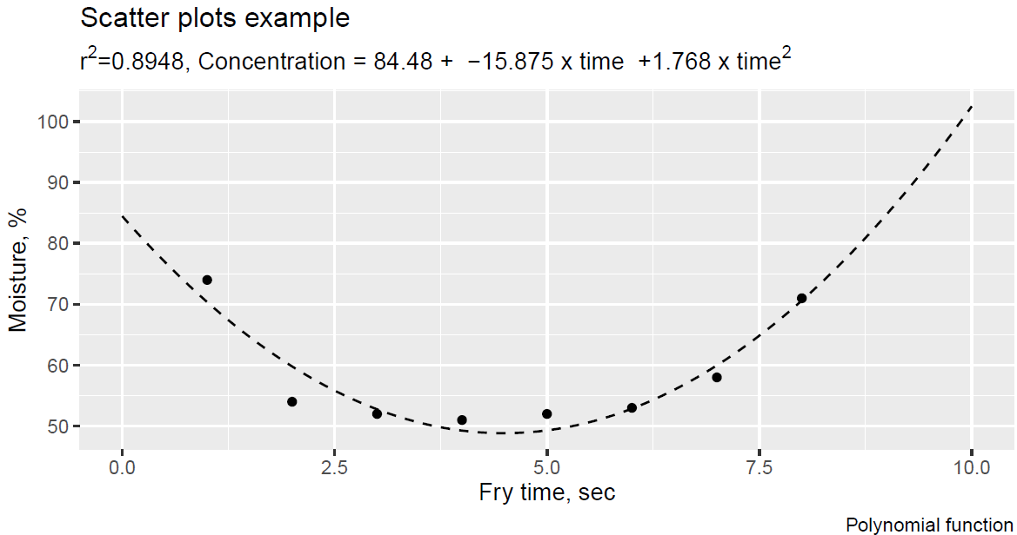
R: Fitting a Polynomial Function

Slide 50
TRY
it
in
R

Slide 51
R: Fitting a Polynomial Function
R_regression_c.R

Slide 52
Smoothing a Scatterplot
Locally Weighted Scatterplot Smoother
LOWESS (or LOESS) method:
Let (x*, y*) denote a particular one of the n (x, y) pairs in the sample.
The value corresponding to (x*, y* ) is obtained by fitting a straight line using only a specified percentage of the data (e.g., 25%) whose x values are closest to x*.
Those with x values closer to x* are more heavily weighted than those whose x values are farther away.
The height of the resulting line above x* is the fitted value .
This process is repeated for each of the n points, so n different lines are fit.
The fitted points are connected to produce a LOWESS curve.

Slide 53
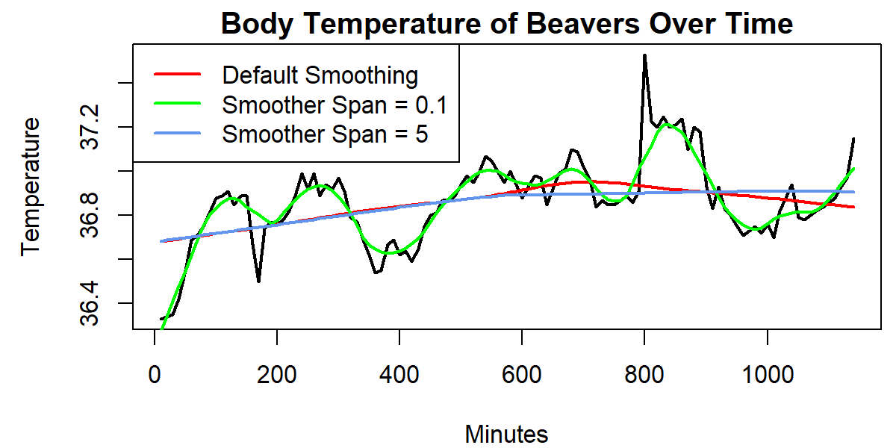
R語言使用Lowess Smoothing
-Use the lowess(x, y, f):
x, y: the input numeric data
f: the smooth span. Larger values give more smoothness

Slide 54
Using More than
One Predictor
Fitting a Linear Function
Creating New Predictors from Existing Ones

Slide 55
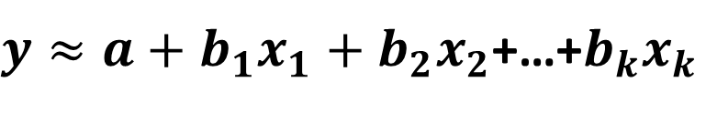
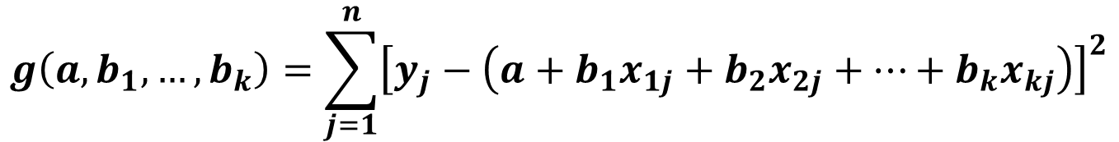
Fitting a Linear Function
Consider fitting a relation of the form:
$y≈a+b_{1}x_{1}+b_{2}x_{2}$+…+$b_{k}x_{k}$
The least squares coefficients a, b₁, b₂,…, b_{k} are the values that minimize g:
$$g\left(a, b_{1},…,b_{k}\right)=\sum_{j=1}^{n}{{\left[y_{j}−\left(a+b_{1}x_{1j}+b_{2}x_{2j}+…+b_{k}x_{kj}\right)\right]}^{2}}$$

Slide 56
R語言使用多元線性迴歸模型
-Use the lm(y~x₁+x₂, data):
data: the input numeric data frame

Slide 57
Creating New Predictors from Existing Ones
以迴歸分析的觀點出發，若是提供越多的Predictor應可以達到更加的擬合結果(R²越大)。但是，實際上應要使用最少的Predictor去達到最佳結果。

Slide 58
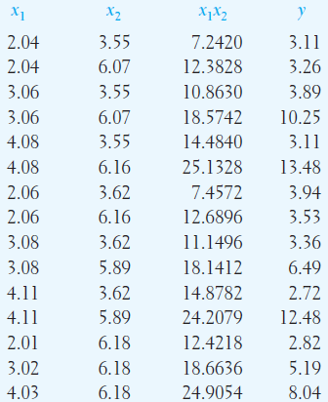
Creating New Predictors from Existing Ones
應變數(Y): deflection
自變數(X₁): shear span ratio
自變數(X₂): splitting tensile strength
資料個數: 15筆

Slide 59
Creating New Predictors from Existing Ones
Fitting y = a + b₁x₁ + b₂x₂

Slide 60
Creating New Predictors from Existing Ones
Including an interaction y = a + b₁x₁ + b₂x₂ + b₃x₁x₂

Slide 61
Creating New Predictors from Existing Ones
Adding quadratic y = a + b₁x₁ + b₂x₂ + b₃x₁x₂ + b₄x₁² + b₅x₂²

Slide 62
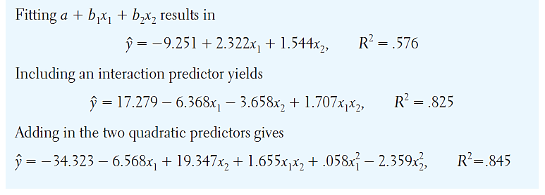
Creating New Predictors from Existing Ones

Slide 63

課堂練習: 學號-姓名-ch9-Regression.R
The data give the speed of cars and distances taken to stop.
data(cars)
(1)請繪製散佈圖(scatter plot)，並計算其Pearson線性相關係數(r)，請試著說明速度(speed, x)與距離(distance, y)之間的關係
(2)請完成線性(y = a+bx)及非線性(y = a+bx+cx²)回歸分析，並試著說明何者較為適合描述速度(speed)與距離(distance)的關係(比較決定係數r²)。請利用次標題顯示r² 與se，透過圖說顯示公式。

Slide 64
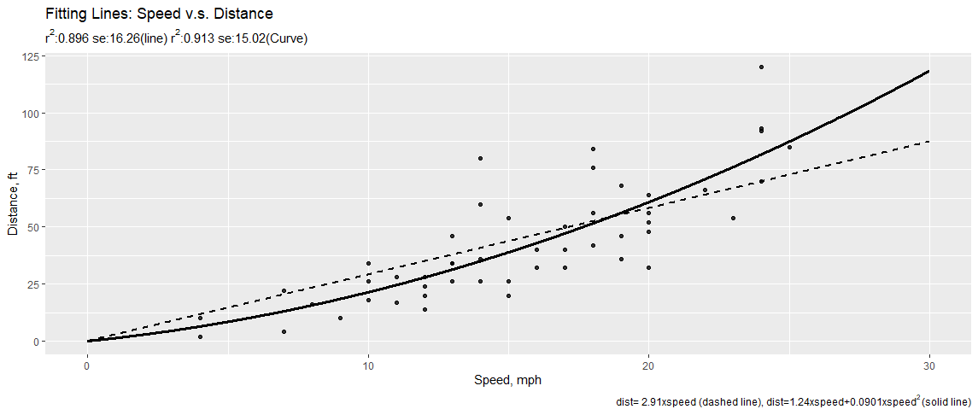
課堂練習: 學號-姓名-ch9-Regression.R

